Slide 1
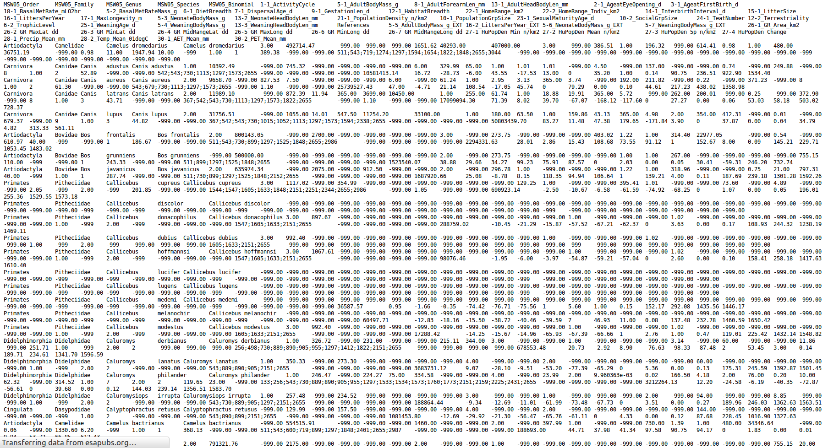
Introduction to Large Datasets
Moreno Di Marco
m.dimarco@uq.edu.au

Slide 2
Big data vs Large datasets
Big data - 3V
Volume – a lot of data are collected and typically made immediately available trough central repository
Velocity - data streams at an incredibly high speed and must be dealt with in a timely manner.
Variety - data comes in all types of formats (text, numbers, pictures, video, audio, etc.)
e.g. Facebook
Large dataset
Miss one or more of the above characteristics
e.g. IUCN Red List
Lots of data, variety of formats, collected daily, but regular releases happen every few months, and major group re-assessments are held every 5-10 years (no velocity)
e.g. WDPA
Updated frequently, but mainly is a vector map (no variety, no large volume)

Slide 3
Which types of data are available?
Non (necessarily) spatial
Demography and Life History Traits
Species extinction risk
Taxonomy & Phylogeny
Typically Spatial
Biogeography
Land Cover & other satellite data
Species Distribution
Climate
Human Pressure Data
Protected Areas/Important Biodiversity Areas

Slide 4
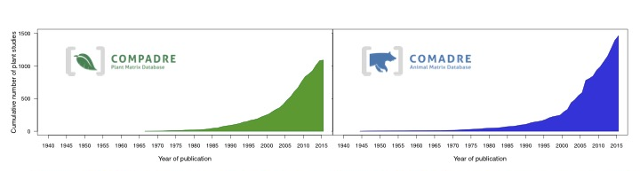
Demography and Life history
Demographic datasets, reporting population matrices. These are structured into ages or stages, and report age-specific survival and reproduction rates
Species life-history trait datasets, including aggregated (not age-specific) demographic parameters. Two examples include Pantheria and AnAge.
These traits can include: body mass, head-body length, age at first reproduction, diet, gestation length, home range, interbirth interval, litter size, longevity, etc.

Slide 5
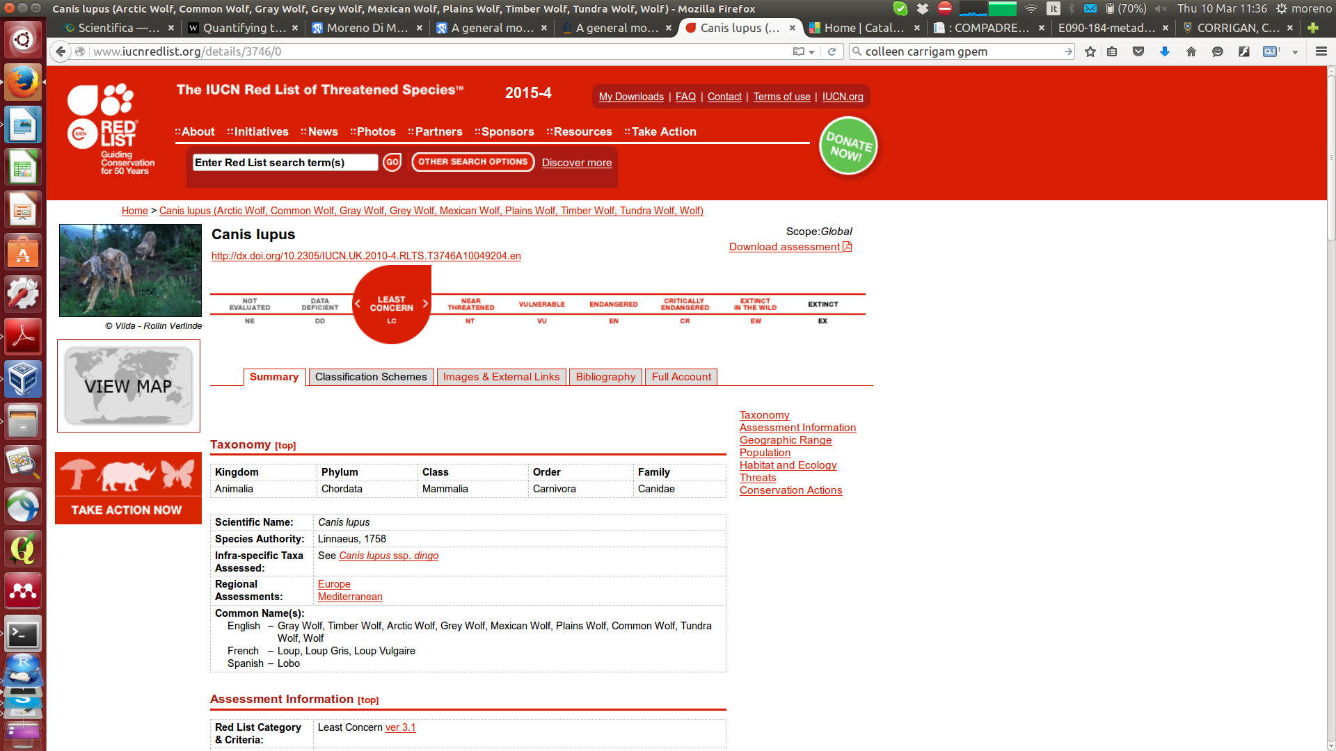
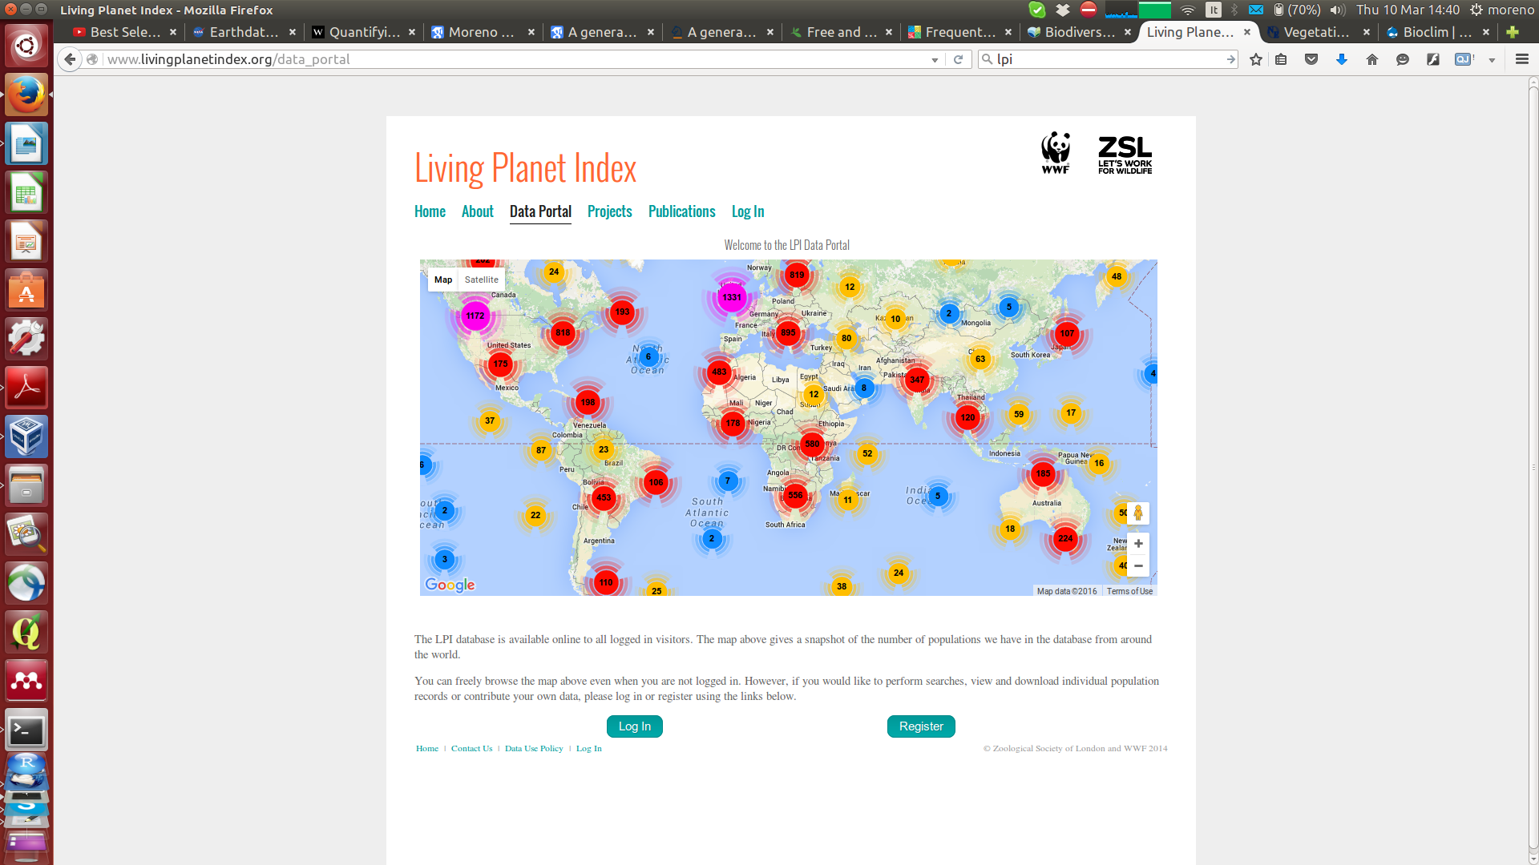
Species axtinction risk

Slide 6
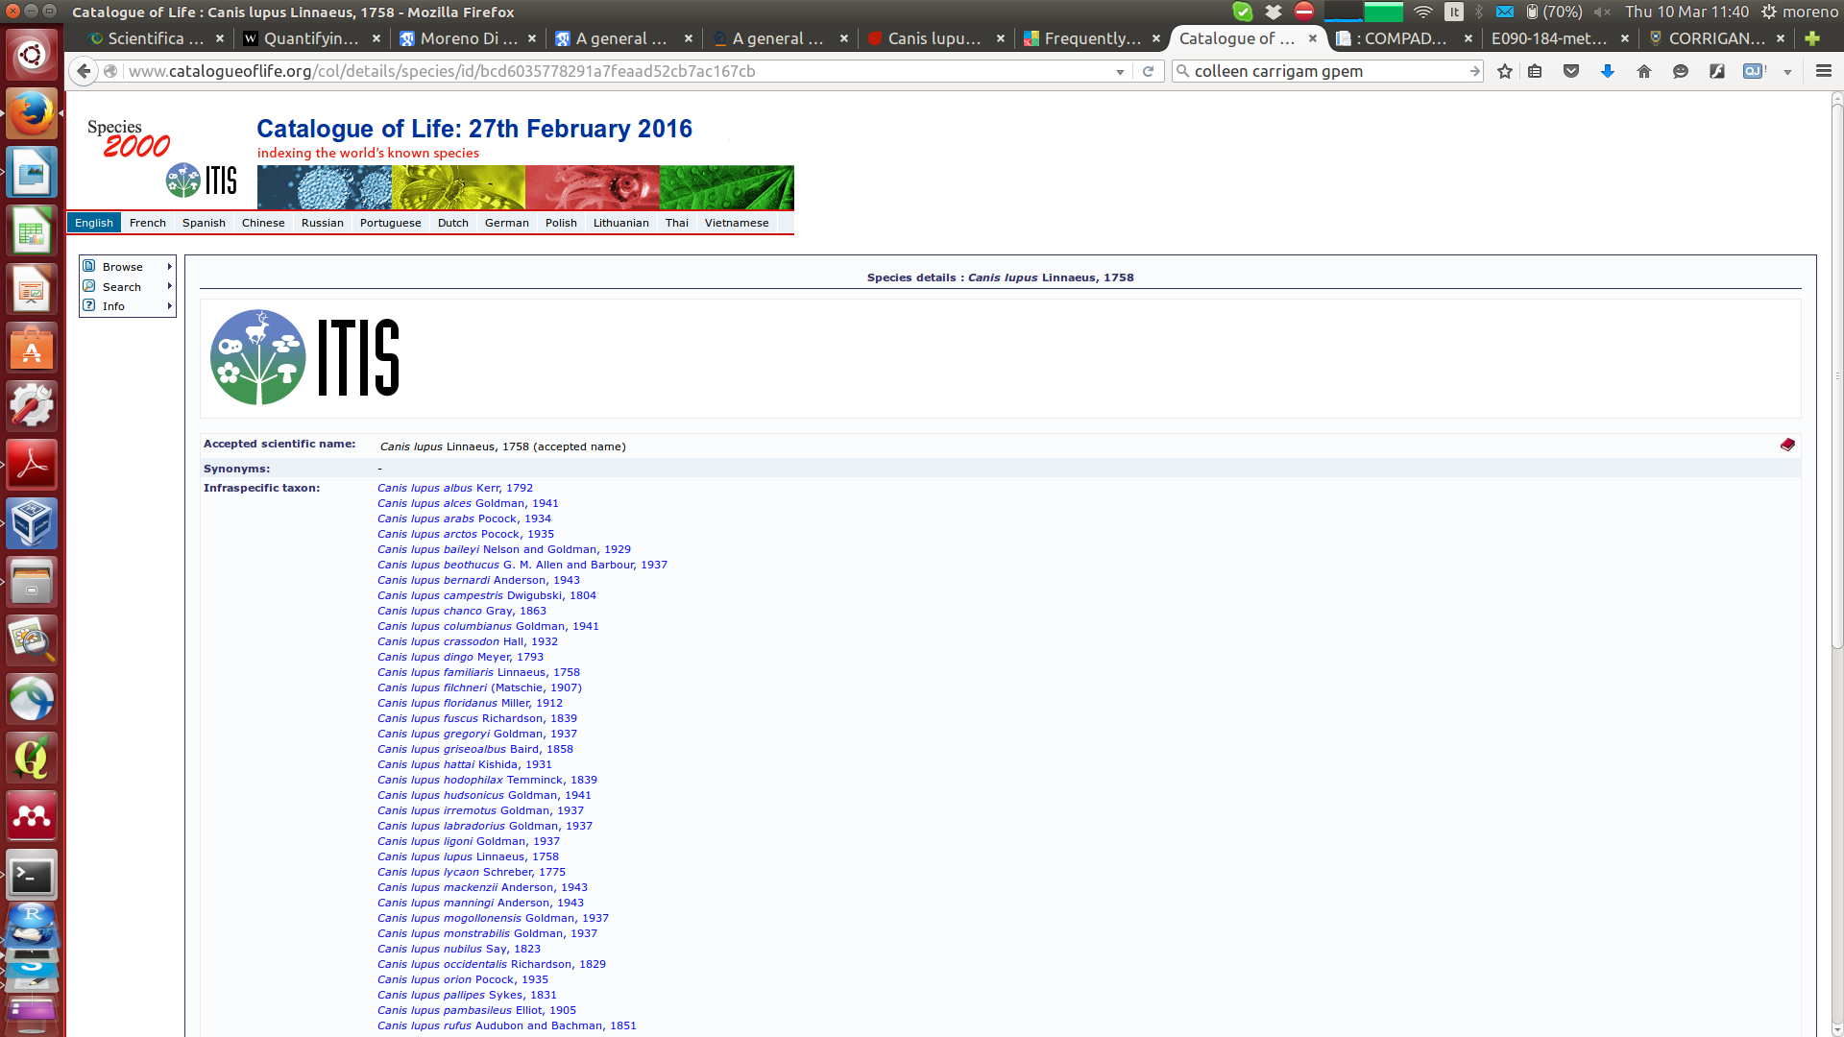
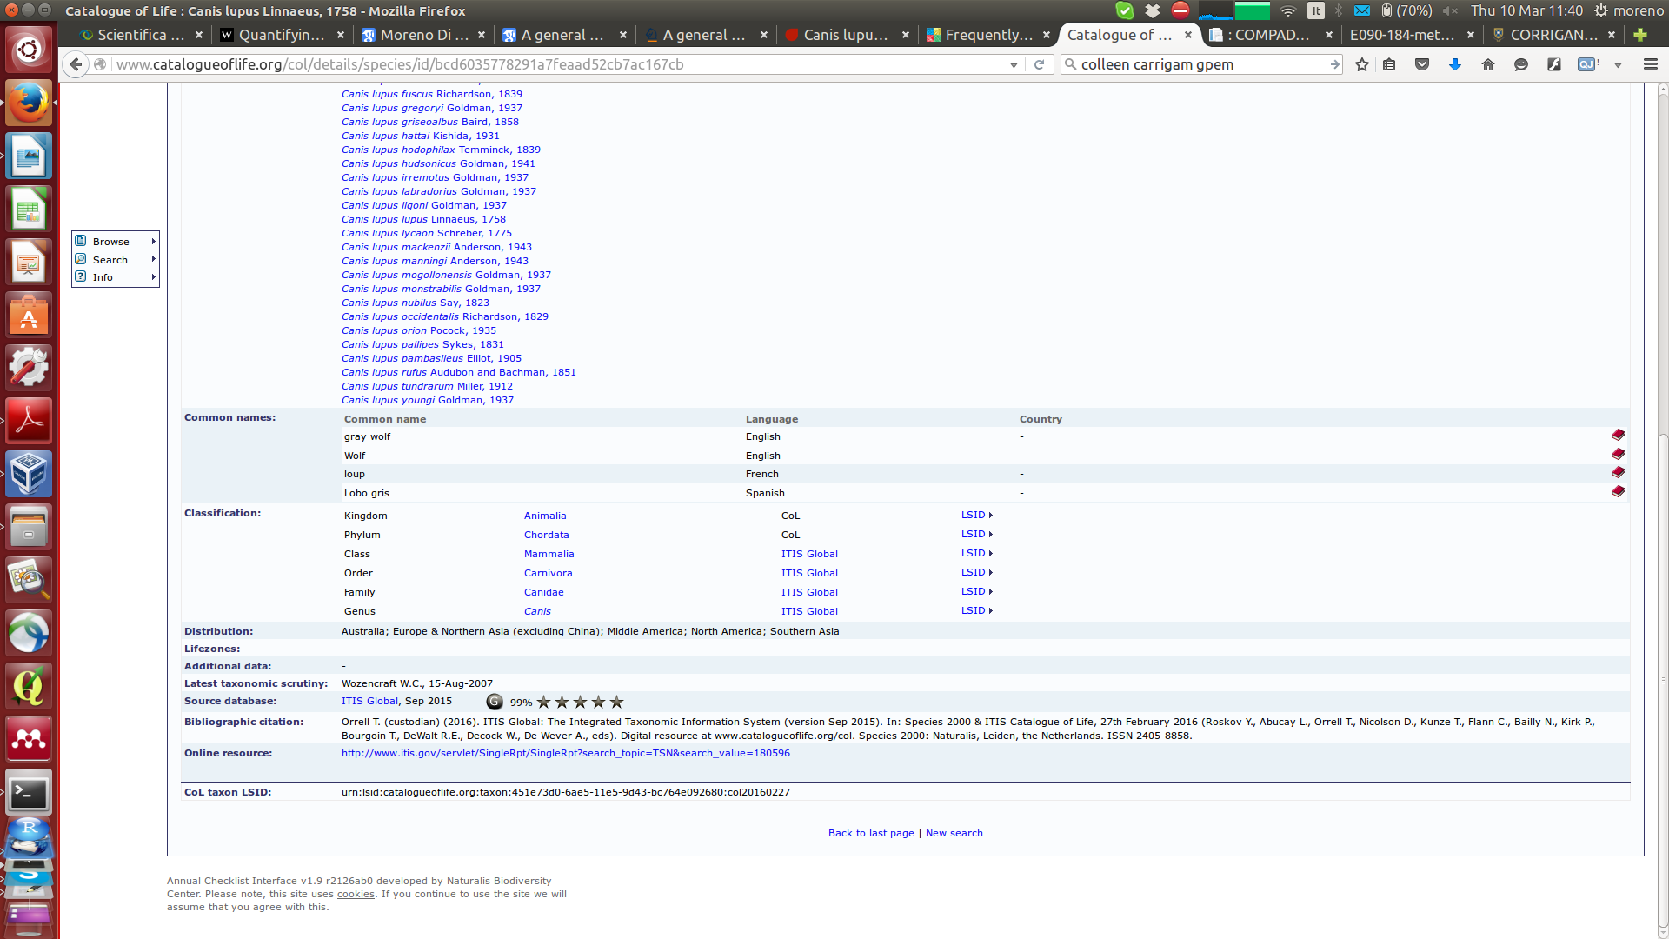
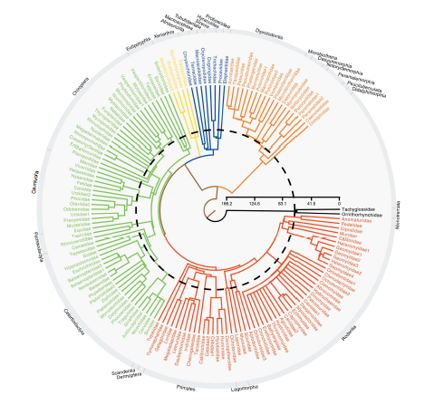
Taxonomy and Phylogeny
Bininda-Emonds et al. 2007 Nature

Slide 7
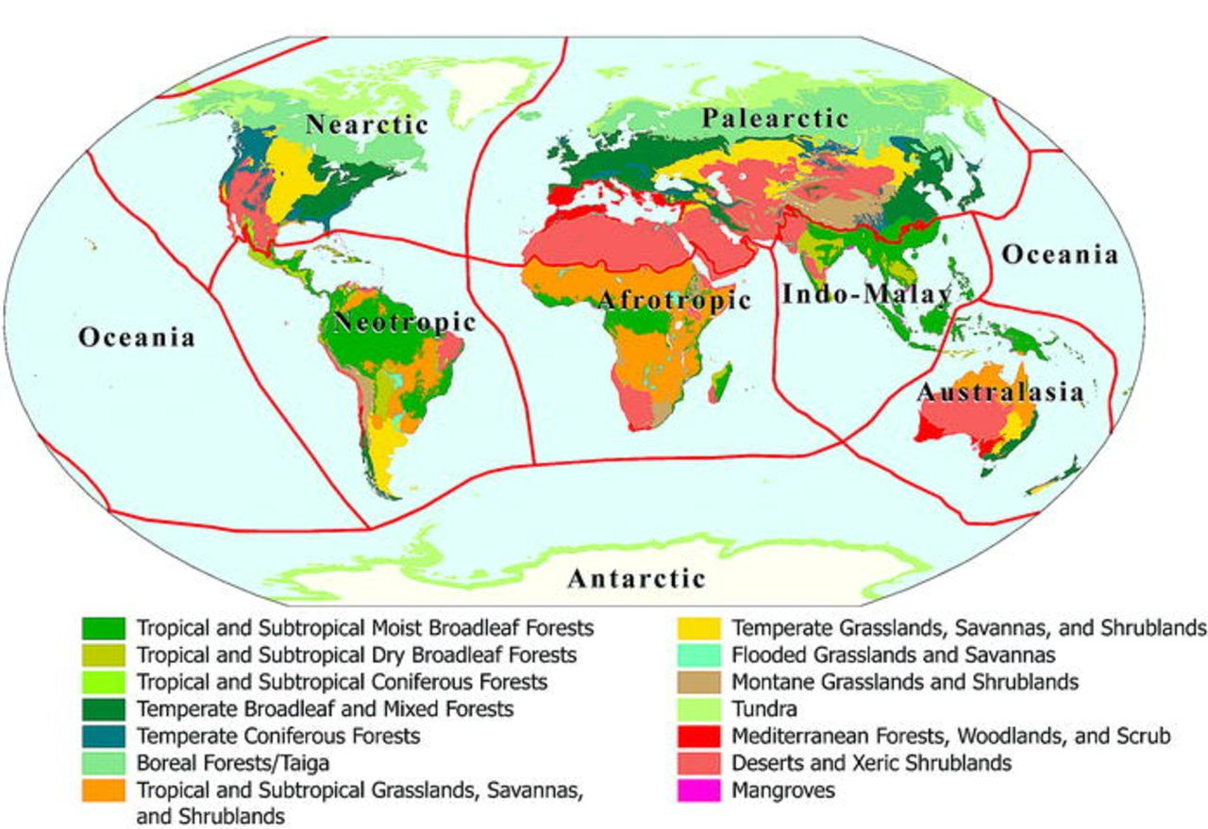
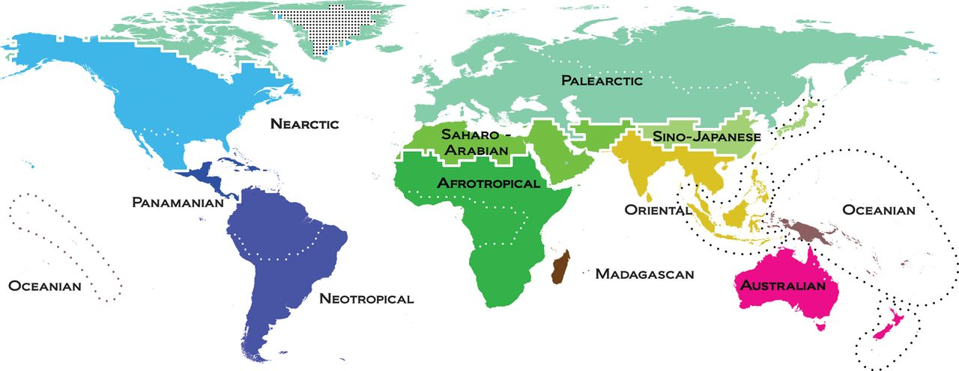
Biogeography
Olson et al. 2001 Bioscience
Holt et al. 2013 Science

Slide 8
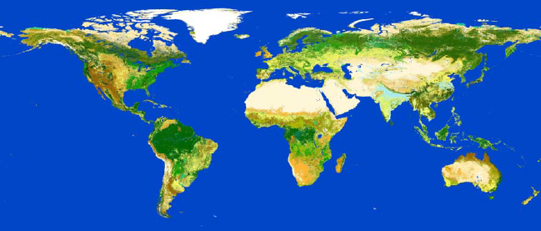
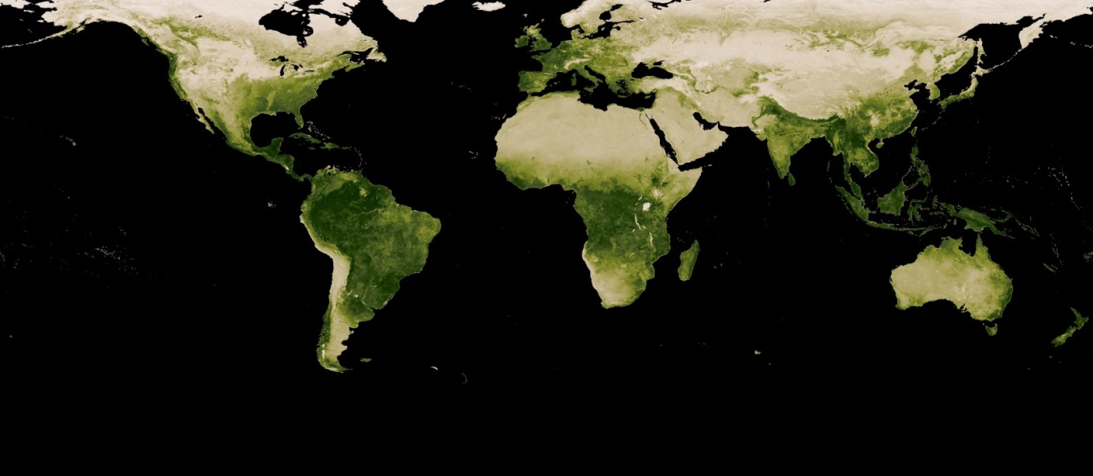
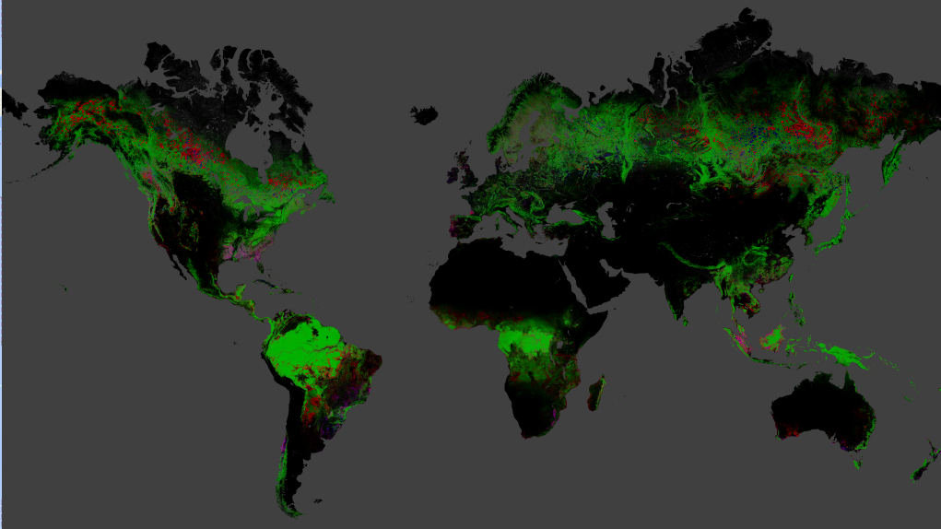
Land Cover and other satellite data
Globcover 2009 http://due.esrin.esa.int/page_globcover.php
NDVI 2016
http://neo.sci.gsfc.nasa.gov/view.php?datasetId=MOD13A2_M_NDVI
Holt et al. 2013 Science

Slide 9
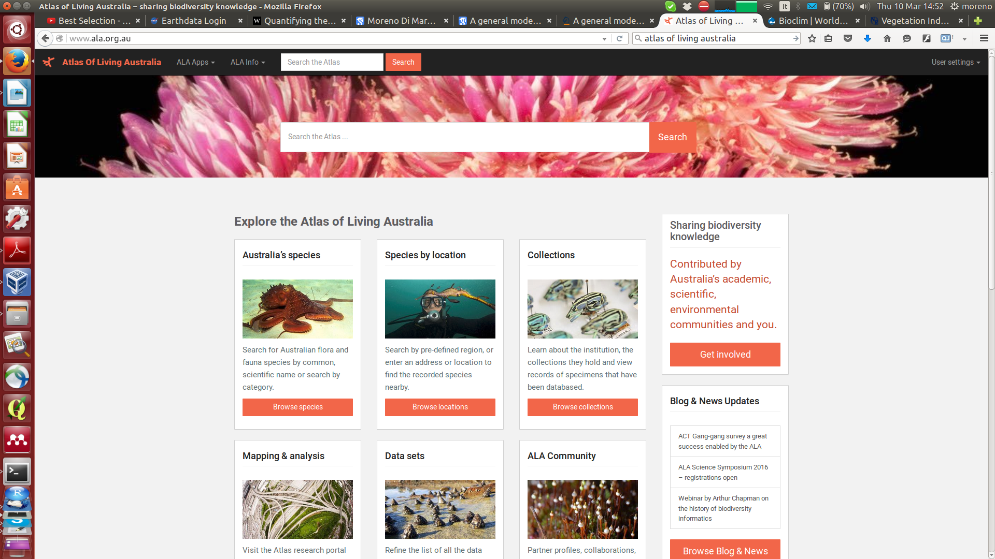
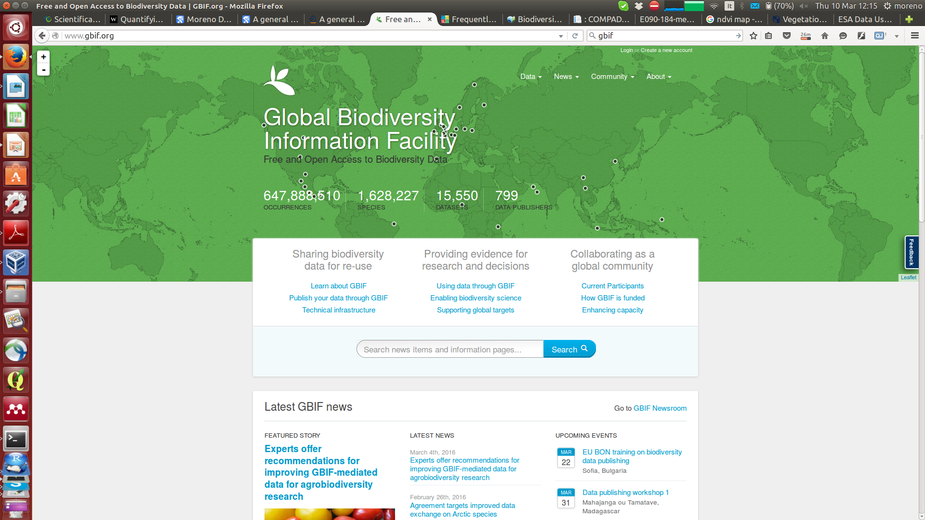
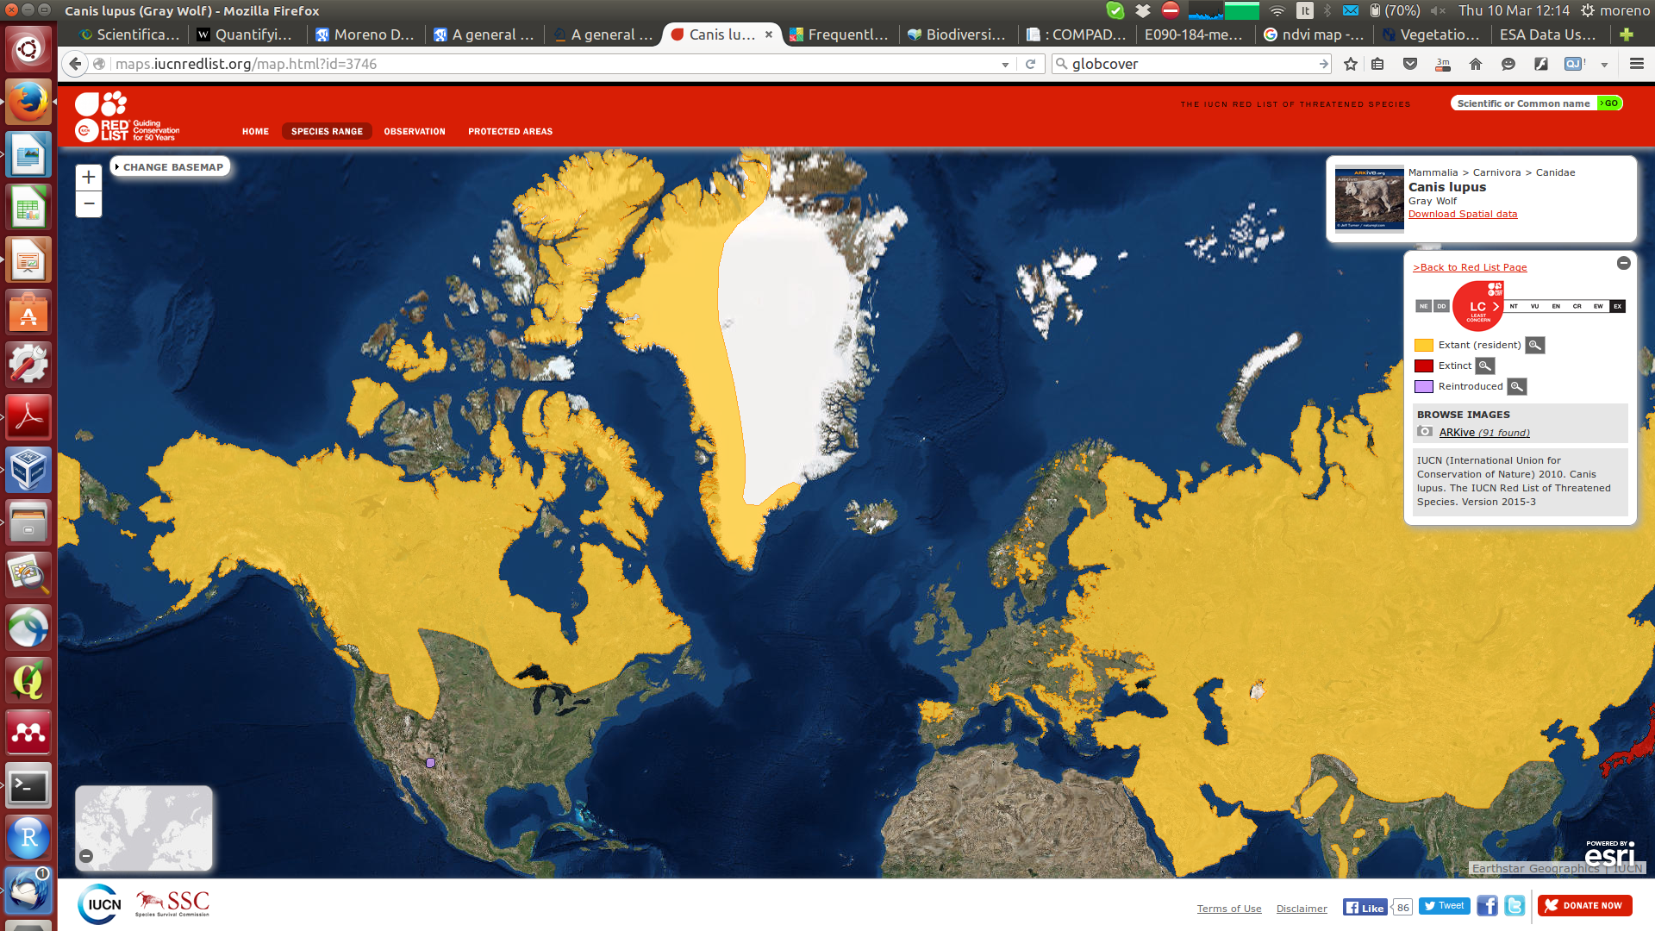
Species distribution

Slide 10
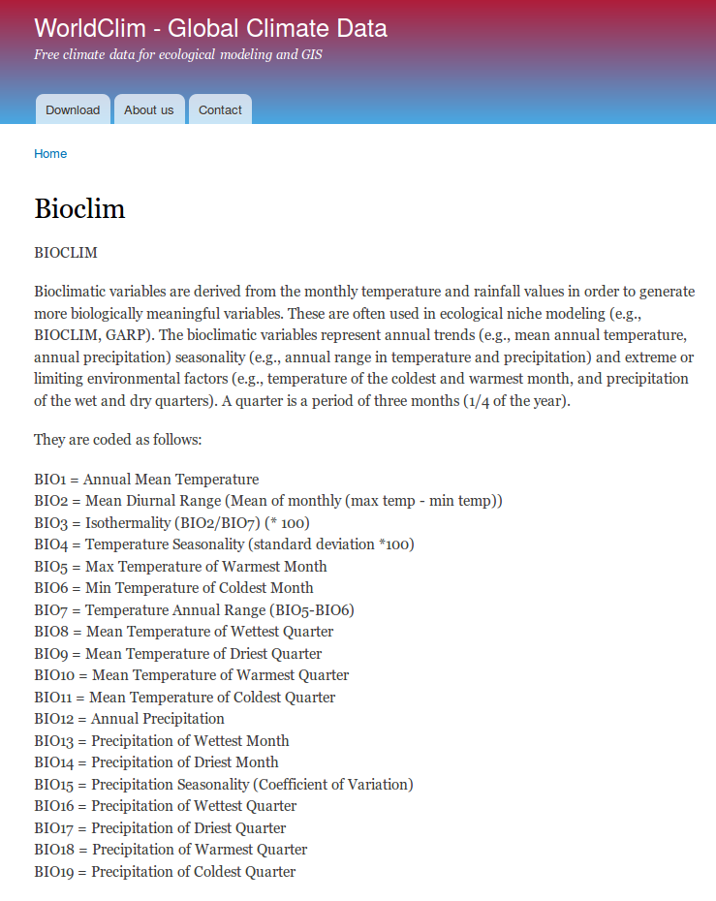
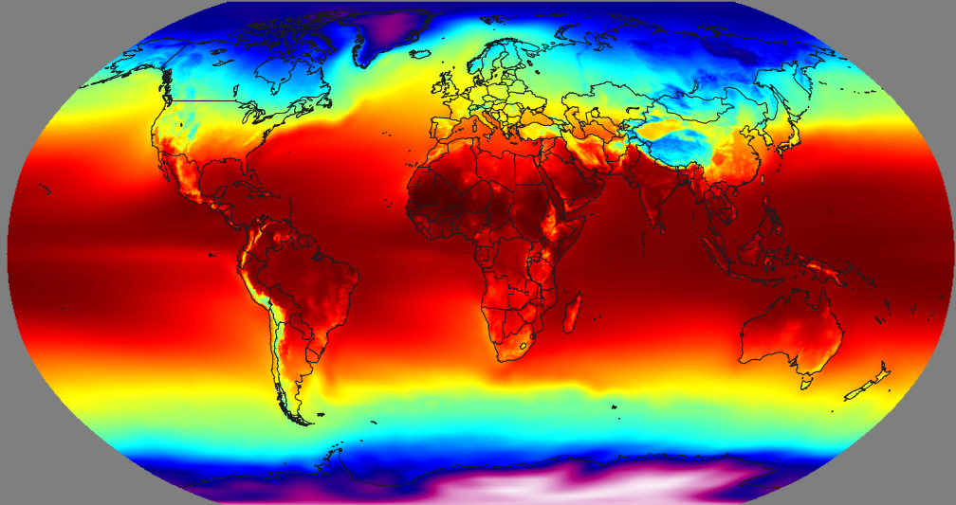
Climate

Slide 11
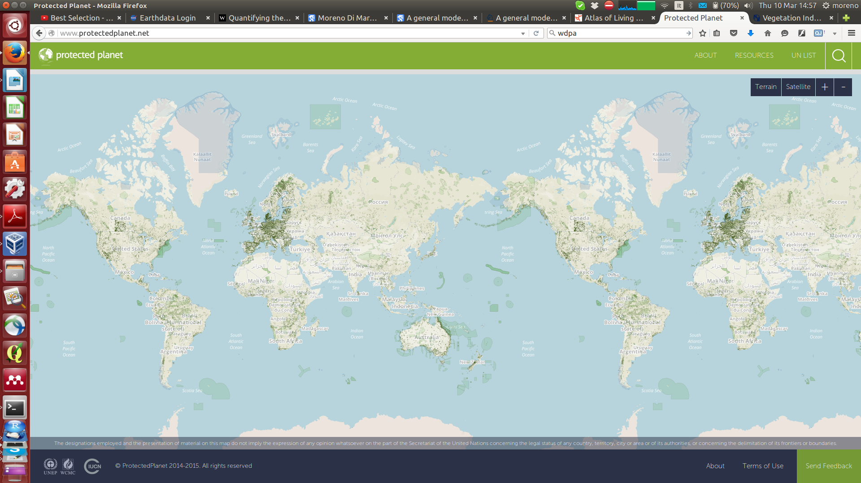
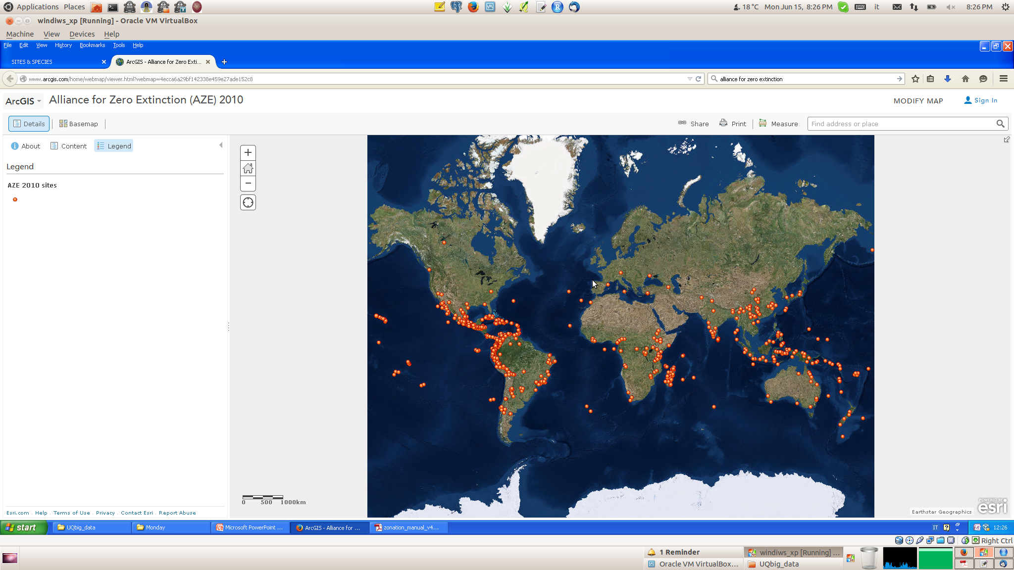
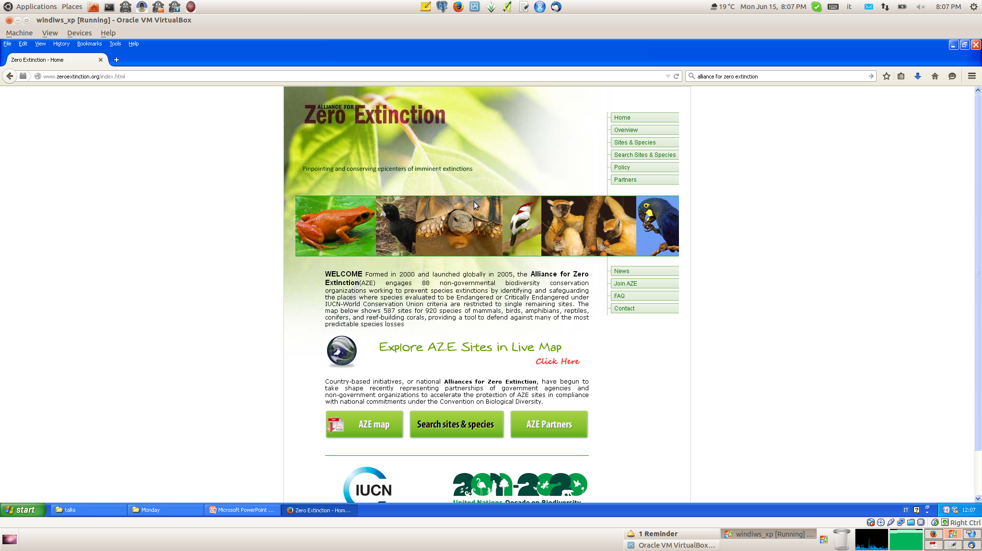
Protected areas, biodiversity areas
The Alliance for Zero extinction sites
http://www.zeroextinction.org/
The World Database on Protected Areas
http://www.protectedplanet.net/

Slide 12
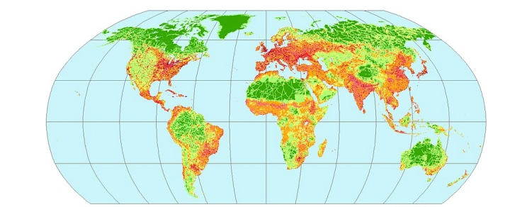
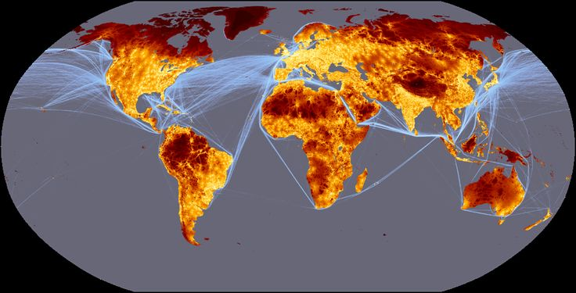
Human pressure layers
Human footprint
Sanderson et al. 2002 Bioscience
Note: Venter et al. updated HFP is now available!
http://forobs.jrc.ec.europa.eu/products/gam/
Travel time from major cities http://forobs.jrc.ec.europa.eu/products/gam/

Slide 13
How to choose the best dataset?
- Is there a reasonable temporal match between my datasets? E.g. Can I use a 2010 land cover map and GBIF points from the 1980s to create a species distribution model for mammals in China?
- Do I have an understanding of the limitations in my data? E.g. Does the IUCN provide accurate map of species presence?
- Spatial extent and spatial resolution - Do all my data have the same spatial extent? E.g. For global-scale analyses, do I have data for islands?
- Previous use – Who has used these data before? For what purpose? Which pre-processing has been done? Do I need to maintain consistency with previous users?
BOTTOM LINE
What is possible is not always interesting, what is interesting is not necessarily useful.
The question/hypothesis should come before the data, i.e. do it because it is important and there are available data, don’t do it just because there are available data.

Slide 14
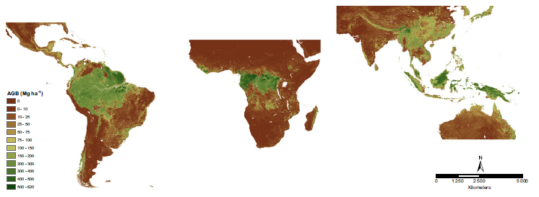
Is the dataset good enough?
Try to use multiple data sources, verify any mismatch, try to understand where these are coming from
Search for other papers comparing different datasets, don’t just use the first data you can get you hands on
Baccini et al., Estimated carbon dioxide emissions from tropical deforestation improved by carbon-density maps. Nat. Clim. Chang. 2, 182–185 (2012).
Saatchi et al., Benchmark map of forest carbon stocks in tropical regions across three continents. PNAS. 108, 9899–9904 (2011).
Avitabile et al., An integrated pan-tropical biomass map using multiple reference datasets. Glob. Chang. Biol., in press, doi:10.1111/gcb.13139.

Slide 15

You ain't nobody until you do what you want! (… with the data you can find)
Arthur H. Fonzarelli "Fonzie" (2016) Pers. Comm.

